Slide 1

Invest in Success with ABC Fast Food Franchise
Delicious Opportunities Await You
Content:
1.Introduction to ABC Fast Food
2.Industry Overview
3.Investment Overview
4.Unique selling proposition(USP)
5.Menu Diversity
6.SWOT Analysis
7.Competitor Analysis
8.Why ABC Fast Food?
-Strength and Advantages
-Positive Customer Review & Testimonial
-Growth Statistics and customer
Satisfaction Trend
9.Support and Training
10.Marketing Strategies
11.Financial Projection
12.Call to Action

Slide 2



Introduction to ABC Fast Food
Brief Overview of ABC Fast Food: ABC Fast Food is a dynamic player in the food industry, offering a delectable range of pizzas, burgers, and chicken-based fast food. Established with a passion for serving high-quality, flavorful meals, ABC Fast Food has quickly become a favorite among food enthusiasts.
Mission and Vision Statement: Our mission is to provide a delightful dining experience by delivering mouthwatering dishes prepared with top-notch ingredients and unparalleled culinary expertise. We envision becoming a global leader in the fast-food industry, synonymous with quality, innovation, and customer satisfaction.
Key Values That Set ABC Fast Food Apart:
Quality: We are committed to using the finest ingredients to ensure the highest standards in taste and freshness.
Innovation: Constantly evolving our menu to excite taste buds and stay ahead of culinary trends.
Customer-Centric: Putting our customers first by delivering exceptional service and a diverse menu to cater to various preferences.

Slide 3
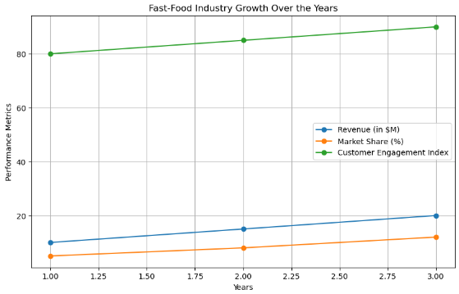
Industry Overview
Snapshot of the Fast-Food Industry:
The fast-food industry is a robust and ever-expanding market, catering to the on-the-go lifestyle of modern consumers.
Rapid urbanization, busy schedules, and changing eating habits contribute to the industry's consistent growth.
Trends and Growth Statistics:
Emphasis on Health: Increasing demand for healthier fast-food alternatives, including salads, grilled options, and plant-based choices.
Digital Transformation: Integration of technology for online ordering, delivery services, and mobile apps, enhancing customer convenience.
Global Expansion: Fast-food chains are exploring new markets, contributing to international growth.

Slide 4
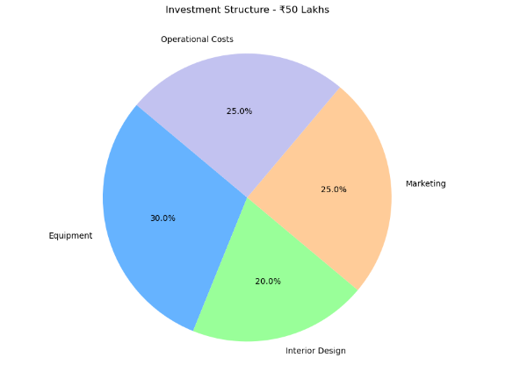
Investment Overview
Investment Required: ₹50 Lakhs
Space Requirement: 1,000 SQ FT
ROI (Return on Investment): Within 24 Months

Slide 5

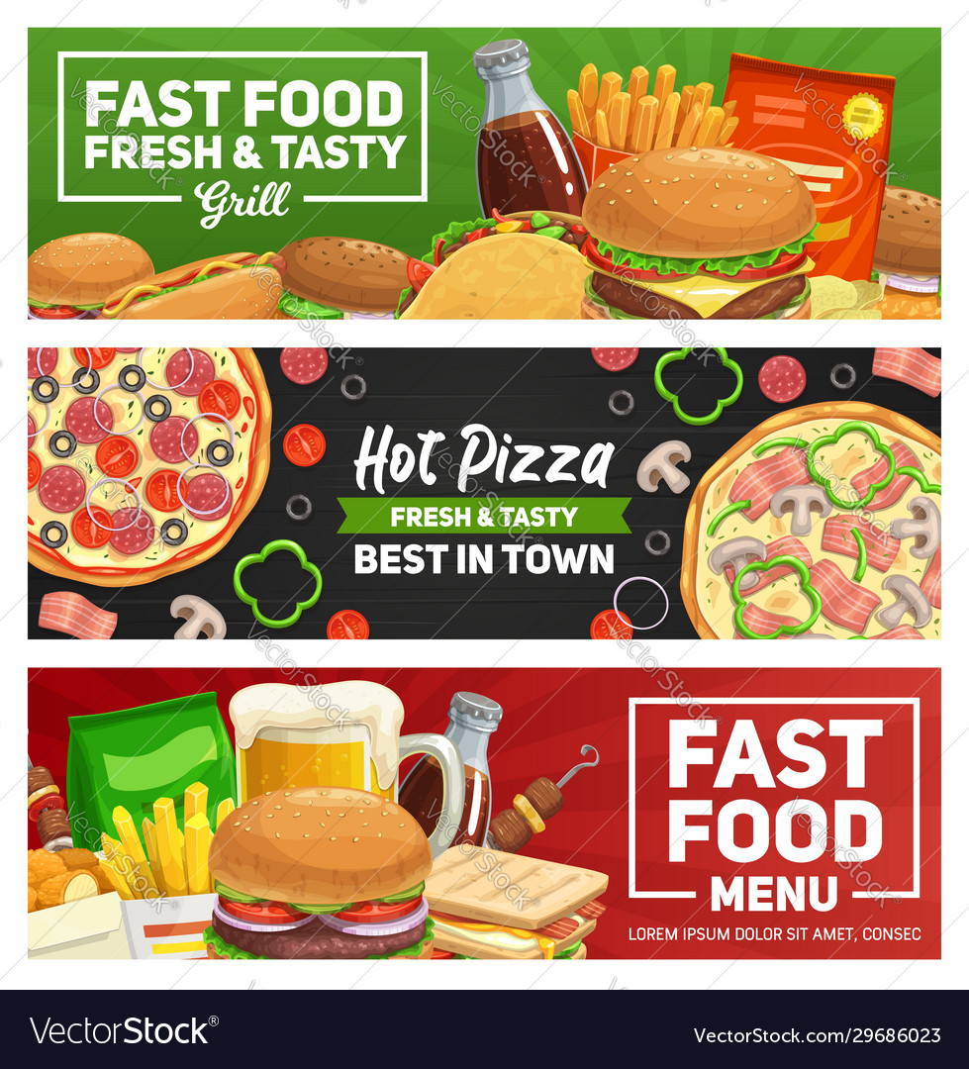
Unique Selling Proposition (USP)
Key Features: Quality Ingredients: We source the finest ingredients to ensure the highest standards in taste and freshness.
Exceptional Taste: Our culinary expertise and commitment to perfection result in a taste that stands out in the fast-food industry.

Slide 6
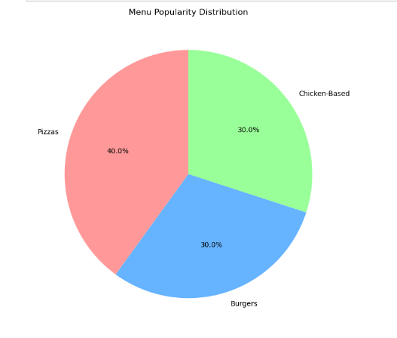
Menu Diversity
Extensive Menu: Pizzas: A delightful array of handcrafted pizzas featuring unique flavors and premium toppings.
Burgers: Mouth-watering burgers prepared with quality ingredients and innovative combinations.
Chicken-Based Offerings: Our diverse selection of chicken dishes, from crispy tenders to flavorful wings.

Slide 7




Strengths:
Quality Ingredients
Established Brand Reputation
Diverse Menu Selection
Strong Customer Loyalty
Weaknesses:
Limited Online Presence
Reliance on Seasonal Ingredients
Operational Complexity in Peak Hours
Regional Concentration of Stores
Opportunities:
Market Expansion in Untapped Regions
Introduction of Healthier Menu Options
Collaborations with Food Delivery Platforms
Incorporating Tech for Online Ordering
Threats:
Intense Competition from Established Chains
Fluctuating Food Prices
Changing Consumer Preferences
Regulatory Changes in the Food Industry
SWOT Analysis

Slide 8
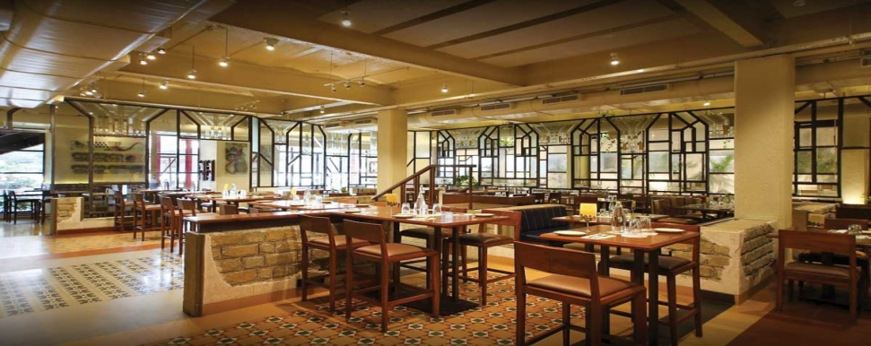
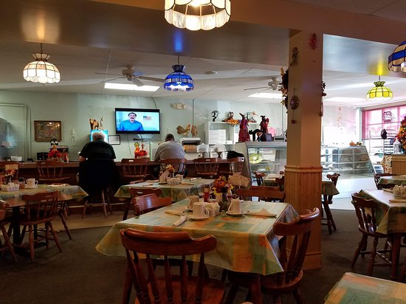
Competitor Analysis
Key Competitors:
Competitor 1: Bingo Burger
Competitor 2: Sabari Fast Food
Competitor 3: Pizza Hut
Weaknesses:
ABC Fast Food:
Limited Online Presence
Regional Concentration
Seasonal Ingredient Reliance
Competitor 1:
Not Well Known Location
Competitor 2:
Ambience s is Not Good
Competitor 3:
Stocked Food
Strengths:
ABC Fast Food:
Diverse and Popular Menu
Strong Brand Loyalty
Efficient Operational Model
Competitor 1:
Very Good Taste
Competitor 2:
Community support
Competitor 3:
Advertising and Popularity

Slide 9



Why ABC Fast Food?
Strengths and Advantages
Quality Ingredients:
Sourcing the finest ingredients for a superior taste.
Diverse Menu:
Extensive choices with pizzas, burgers, and chicken-based offerings.
Established Brand:
A strong and recognized brand in the fast-food industry.
Customer Loyalty:
Building strong relationships through exceptional service.

Slide 10

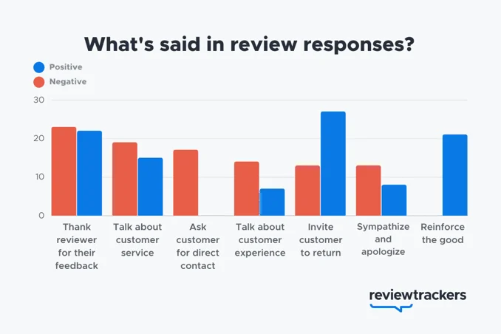
Positive Customer Reviews and Testimonials
What Our Customers Say:
"Delicious food with a variety of options!"
"ABC Fast Food never disappoints – consistently tasty."
"Excellent service and quality; my go-to fast-food choice."

Slide 11
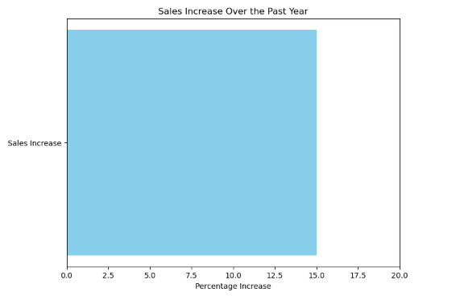
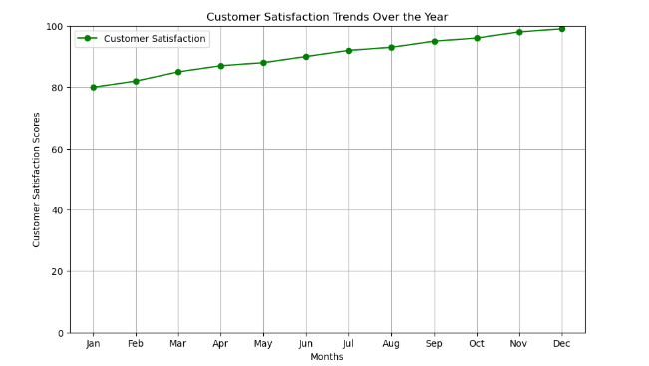
Growth Statistics and Customer Satisfaction Trends
Growth Statistics:
X% (specific numeric value)increase in sales over the past year.
Expanded to X new locations, reaching a broader audience.
Customer Satisfaction Trends:
Graph showing the upward trend in customer satisfaction scores.

Slide 12
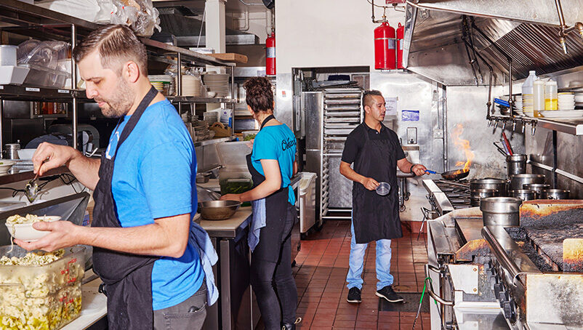

Support and Training
Training Program:
Comprehensive training sessions for franchisees.
Skill development in food preparation, customer service, and business operations.
Ongoing support and refresher courses.
Support Services:
Dedicated support team available for assistance.
Regular check-ins and updates to ensure franchisee success.
Access to an online knowledge base and resources.

Slide 13


Marketing Strategies
Targeted Advertising:
Digital marketing campaigns tailored for specific demographics.
Utilization of social media platforms for brand visibility.
Collaborations with influencers for increased reach.
Promotions and Loyalty Programs:
Regular promotions to attract new customers.
Implementing a customer loyalty program to retain and reward frequent visitors.
Limited-time offers and discounts for increased footfall.
Community Engagement:
Localized marketing initiatives to connect with the community.
Sponsorship of local events and partnerships with nearby businesses.
Participation in community fundraisers or charity events.

Slide 14
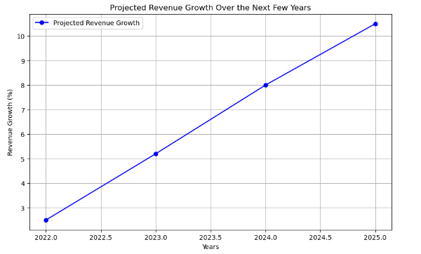
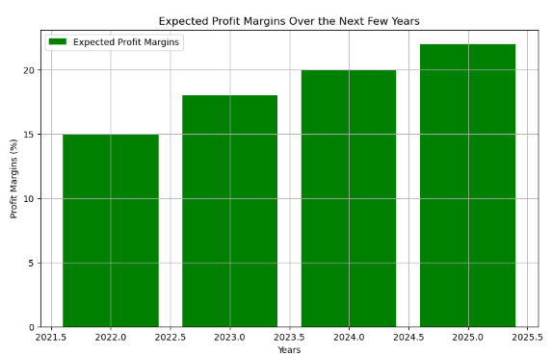
Financial Projections
Projected Revenue:
Anticipated revenue growth based on market trends and expansion plans.
Detailed breakdown by product category (pizzas, burgers, chicken-based offerings).
Profit Margins:
Expected profit margins for the next fiscal years.
Factors influencing profit margins, such as cost control and operational efficiency.

Slide 15


Call to Action
Next Steps:
"Ready to Join the ABC Fast Food Success Story?"
"Contact us to Begin Your Franchise Journey!"
"Explore the Exciting Opportunities Waiting for You."
Contact Information:
Email: franchise@abcfastfood.com
Phone: +123 456 7890
Website: www.abcfastfoodfranchise.com
How to Proceed:
Schedule a one-on-one consultation with our franchise experts.
Complete the franchise application form on our website.
Attend our upcoming franchise information sessions for in-depth insights.

